Slide 1
Chapter 6 - Functions

Slide 2
3.1 Introduction
Divide and conquer
  Construct a program from smaller pieces or components
  Each piece more manageable than the original program

Slide 3
3.2 Program Components in C++
Modules: functions and classes
Programs use new and “prepackaged” modules
  New: programmer-defined functions, classes
  Prepackaged: from the standard library
Functions invoked by function call
  Function name and information (arguments) it needs
Function definitions
  Only written once
  Hidden from other functions

Slide 4
3.2 Program Components in C++
Boss to worker analogy
  A boss (the calling function or caller) asks a worker (the called function) to perform a task and return (i.e., report back) the results when the task is done.

Slide 5
3.3 Math Library Functions
Perform common mathematical calculations
  Include the header file <cmath>
Functions called by writing
  functionName (argument);
  or
  functionName(argument1, argument2, …);
Example
  cout << sqrt( 900.0 );
  sqrt (square root) function The preceding statement would print 30
  All functions in math library return a double

Slide 6
3.3 Math Library Functions
Function arguments can be
  Constants
    sqrt( 4 );
  Variables
    sqrt( x );
  Expressions
    sqrt( sqrt( x ) ) ;
    sqrt( 3 - 6x );

Slide 7
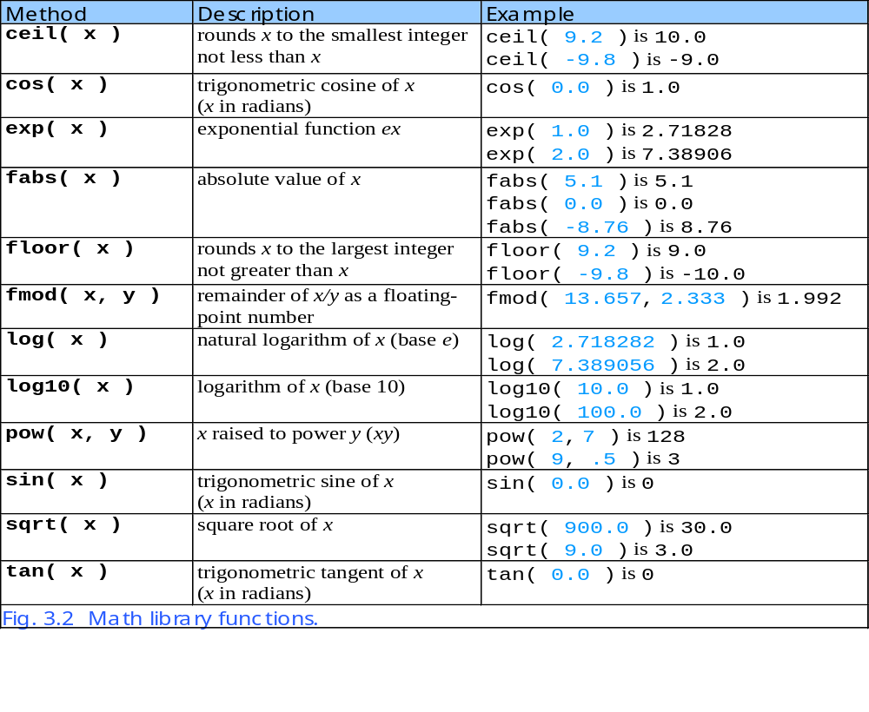

Slide 8
3.4 Functions
Functions
  Modularize a program
  Software reusability
    Call function multiple times
Local variables
  Known only in the function in which they are defined
  All variables declared in function definitions are local variables
Parameters
  Local variables passed to function when called
  Provide outside information

Slide 9
3.5 Function Definitions
Function prototype
  Tells compiler argument type and return type of function
  int square( int );
    Function takes an int and returns an int
  Explained in more detail later
Calling/invoking a function
  square(x);
  Parentheses an operator used to call function
    Pass argument x
    Function gets its own copy of arguments
  After finished, passes back result

Slide 10
3.5 Function Definitions
Format for function definition
  return-value-type function-name( parameter-list )
  {
  declarations and statements
  }
  Parameter list
    Comma separated list of arguments
      Data type needed for each argument
    If no arguments, use void or leave blank
  Return-value-type
    Data type of result returned (use void if nothing returned)

Slide 11
3.5 Function Definitions
Example function
  int square( int y )
  {
  return y * y;
  }
return keyword
  Returns data, and control goes to function’s caller
    If no data to return, use return;
  Function ends when reaches right brace
    Control goes to caller
Functions cannot be defined inside other functions
Next: program examples

Slide 12
fig03_03.cpp
(1 of 2)
1 // Fig. 3.3: fig03_03.cpp
2 // Creating and using a programmer-defined function.
3 #include <iostream>
4
5 using std::cout;
6 using std::endl;
7
8 int square( int ); // function prototype
9
10 int main()
11 {
12 // loop 10 times and calculate and output
13 // square of x each time
14 for ( int x = 1; x <= 10; x++ )
15 cout << square( x ) << " "; // function call
16
17 cout << endl;
18
19 return 0; // indicates successful termination
20
21 } // end main
22
Function prototype: specifies data types of arguments and return values. square expects and int, and returns an int.
Parentheses () cause function to be called. When done, it returns the result.

Slide 13
fig03_03.cpp
(2 of 2) fig03_03.cpp output (1 of 1)
23 // square function definition returns square of an integer
24 int square( int y ) // y is a copy of argument to function
25 {
26 return y * y; // returns square of y as an int
27
28 } // end function square
Definition of square. y is a copy of the argument passed. Returns y * y, or y squared.
1 4 9 16 25 36 49 64 81 100

Slide 14
fig03_04.cpp
(1 of 2)
1 // Fig. 3.4: fig03_04.cpp
2 // Finding the maximum of three floating-point numbers.
3 #include <iostream>
4
5 using std::cout;
6 using std::cin;
7 using std::endl;
8
9 double maximum( double, double, double ); // function prototype
10
11 int main()
12 {
13 double number1;
14 double number2;
15 double number3;
16
17 cout << "Enter three floating-point numbers: ";
18 cin >> number1 >> number2 >> number3;
19
20 // number1, number2 and number3 are arguments to
21 // the maximum function call
22 cout << "Maximum is: "
23 << maximum( number1, number2, number3 ) << endl;
24
25 return 0; // indicates successful termination
Function maximum takes 3 arguments (all double) and returns a double.

Slide 15
fig03_04.cpp
(2 of 2) fig03_04.cpp output (1 of 1)
26
27 } // end main
28
29 // function maximum definition;
30 // x, y and z are parameters
31 double maximum( double x, double y, double z )
32 {
33 double max = x; // assume x is largest
34
35 if ( y > max ) // if y is larger,
36 max = y; // assign y to max
37
38 if ( z > max ) // if z is larger,
39 max = z; // assign z to max
40
41 return max; // max is largest value
42
43 } // end function maximum
Comma separated list for multiple parameters.
Enter three floating-point numbers: 99.32 37.3 27.1928
Maximum is: 99.32
Enter three floating-point numbers: 1.1 3.333 2.22
Maximum is: 3.333
Enter three floating-point numbers: 27.9 14.31 88.99
Maximum is: 88.99

Slide 16
3.6 Function Prototypes
Function prototype contains
  Function name
  Parameters (number and data type)
  Return type (void if returns nothing)
  Only needed if function definition after function call
Prototype must match function definition
  Function prototype
    double maximum( double, double, double );
  Definition
    double maximum( double x, double y, double z )
    {
    …
    }

Slide 17
3.6 Function Prototypes
Function signature
  Part of prototype with name and parameters
    double maximum( double, double, double );
Argument Coercion
  Force arguments to be of proper type
    Converting int (4) to double (4.0)
    cout << sqrt(4)
  Conversion rules
    Arguments usually converted automatically
    Changing from double to int can truncate data
      3.4 to 3
  Mixed type goes to highest type (promotion)
    int * double
Function signature

Slide 18
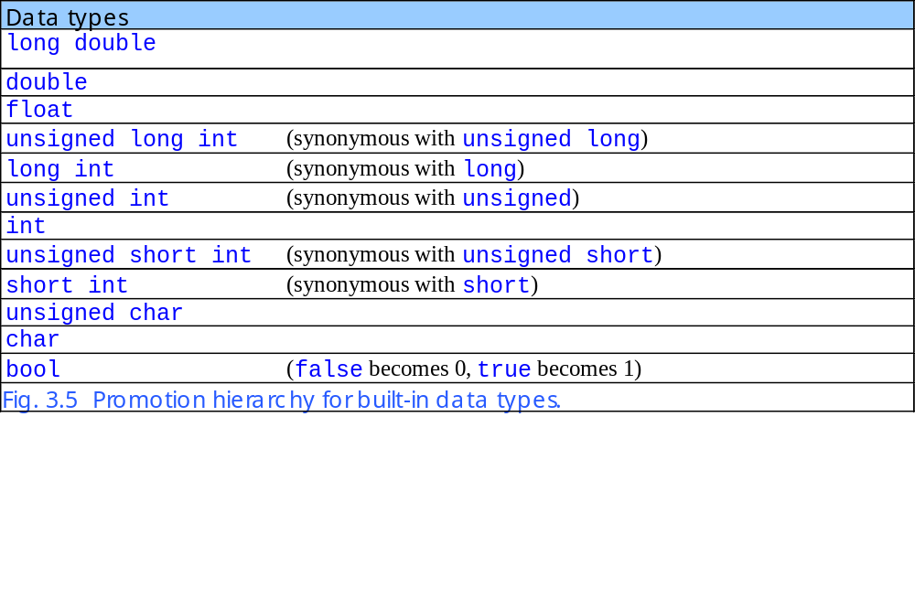
3.6 Function Prototypes

Slide 19
3.7 Header Files
Header files contain
  Function prototypes
  Definitions of data types and constants
Header files ending with .h
  Programmer-defined header files
    #include “myheader.h”
Library header files
    #include <cmath>

Slide 20
3.8 Random Number Generation
rand function (<cstdlib>)
  i = rand();
  Generates unsigned integer between 0 and RAND_MAX (usually 32767)
Scaling and shifting
  Modulus (remainder) operator: %
    10 % 3 is 1
    x % y is between 0 and y – 1
  Example
      i = rand() % 6 + 1;
    “Rand() % 6” generates a number between 0 and 5 (scaling)
    “+ 1” makes the range 1 to 6 (shift)
  Next: program to roll dice

Slide 21
fig03_07.cpp
(1 of 2)
1 // Fig. 3.7: fig03_07.cpp
2 // Shifted, scaled integers produced by 1 + rand() % 6.
3 #include <iostream>
4
5 using std::cout;
6 using std::endl;
7
8 #include <iomanip>
9
10 using std::setw;
11
12 #include <cstdlib> // contains function prototype for rand
13
14 int main()
15 {
16 // loop 20 times
17 for ( int counter = 1; counter <= 20; counter++ ) {
18
19 // pick random number from 1 to 6 and output it
20 cout << setw( 10 ) << ( 1 + rand() % 6 );
21
22 // if counter divisible by 5, begin new line of output
23 if ( counter % 5 == 0 )
24 cout << endl;
25
26 } // end for structure
Output of rand() scaled and shifted to be a number between 1 and 6.

Slide 22
fig03_07.cpp
(2 of 2) fig03_07.cpp output (1 of 1)
27
28 return 0; // indicates successful termination
29
30 } // end main
6 6 5 5 6
5 1 1 5 3
6 6 2 4 2
6 2 3 4 1

Slide 23
3.8 Random Number Generation
Next
  Program to show distribution of rand()
  Simulate 6000 rolls of a die
  Print number of 1’s, 2’s, 3’s, etc. rolled
  Should be roughly 1000 of each

Slide 24
fig03_08.cpp
(1 of 3)
1 // Fig. 3.8: fig03_08.cpp
2 // Roll a six-sided die 6000 times.
3 #include <iostream>
4
5 using std::cout;
6 using std::endl;
7
8 #include <iomanip>
9
10 using std::setw;
11
12 #include <cstdlib> // contains function prototype for rand
13
14 int main()
15 {
16 int frequency1 = 0;
17 int frequency2 = 0;
18 int frequency3 = 0;
19 int frequency4 = 0;
20 int frequency5 = 0;
21 int frequency6 = 0;
22 int face; // represents one roll of the die
23

Slide 25
fig03_08.cpp
(2 of 3)
24 // loop 6000 times and summarize results
25 for ( int roll = 1; roll <= 6000; roll++ ) {
26 face = 1 + rand() % 6; // random number from 1 to 6
27
28 // determine face value and increment appropriate counter
29 switch ( face ) {
30
31 case 1: // rolled 1
32 ++frequency1;
33 break;
34
35 case 2: // rolled 2
36 ++frequency2;
37 break;
38
39 case 3: // rolled 3
40 ++frequency3;
41 break;
42
43 case 4: // rolled 4
44 ++frequency4;
45 break;
46
47 case 5: // rolled 5
48 ++frequency5;
49 break;

Slide 26
fig03_08.cpp
(3 of 3)
50
51 case 6: // rolled 6
52 ++frequency6;
53 break;
54
55 default: // invalid value
56 cout << "Program should never get here!";
57
58 } // end switch
59
60 } // end for
61
62 // display results in tabular format
63 cout << "Face" << setw( 13 ) << "Frequency"
64 << "\n 1" << setw( 13 ) << frequency1
65 << "\n 2" << setw( 13 ) << frequency2
66 << "\n 3" << setw( 13 ) << frequency3
67 << "\n 4" << setw( 13 ) << frequency4
68 << "\n 5" << setw( 13 ) << frequency5
69 << "\n 6" << setw( 13 ) << frequency6 << endl;
70
71 return 0; // indicates successful termination
72
73 } // end main
Default case included even though it should never be reached. This is a matter of good coding style

Slide 27
fig03_08.cpp output (1 of 1)
Face Frequency
1 1003
2 1017
3 983
4 994
5 1004
6 999

Slide 28
3.8 Random Number Generation
Calling rand() repeatedly
  Gives the same sequence of numbers
Pseudorandom numbers
  Preset sequence of "random" numbers
  Same sequence generated whenever program run
To get different random sequences
  Provide a seed value
    Like a random starting point in the sequence
    The same seed will give the same sequence
  srand(seed);
    <cstdlib>
    Used before rand() to set the seed

Slide 29
fig03_09.cpp
(1 of 2)
1 // Fig. 3.9: fig03_09.cpp
2 // Randomizing die-rolling program.
3 #include <iostream>
4
5 using std::cout;
6 using std::cin;
7 using std::endl;
8
9 #include <iomanip>
10
11 using std::setw;
12
13 // contains prototypes for functions srand and rand
14 #include <cstdlib>
15
16 // main function begins program execution
17 int main()
18 {
19 unsigned seed;
20
21 cout << "Enter seed: ";
22 cin >> seed;
23 srand( seed ); // seed random number generator
24
Setting the seed with srand().

Slide 30
fig03_09.cpp
(2 of 2) fig03_09.cpp output (1 of 1)
25 // loop 10 times
26 for ( int counter = 1; counter <= 10; counter++ ) {
27
28 // pick random number from 1 to 6 and output it
29 cout << setw( 10 ) << ( 1 + rand() % 6 );
30
31 // if counter divisible by 5, begin new line of output
32 if ( counter % 5 == 0 )
33 cout << endl;
34
35 } // end for
36
37 return 0; // indicates successful termination
38
39 } // end main
rand() gives the same sequence if it has the same initial seed.
Enter seed: 67
6 1 4 6 2
1 6 1 6 4
Enter seed: 432
4 6 3 1 6
3 1 5 4 2
Enter seed: 67
6 1 4 6 2
1 6 1 6 4

Slide 31
3.8 Random Number Generation
Can use the current time to set the seed
  No need to explicitly set seed every time
  srand( time( 0 ) );
  time( 0 );
    <ctime>
    Returns current time in seconds
General shifting and scaling
  Number = shiftingValue + rand() % scalingFactor
  shiftingValue = first number in desired range
  scalingFactor = width of desired range

Slide 32
3.9 Example: Game of Chance and Introducing enum
Enumeration
  Set of integers with identifiers
  enum typeName {constant1, constant2…};
  Constants start at 0 (default), incremented by 1
  Constants need unique names
  Cannot assign integer to enumeration variable
    Must use a previously defined enumeration type
Example
  enum Status {CONTINUE, WON, LOST};
  Status enumVar;
  enumVar = WON; // cannot do enumVar = 1

Slide 33
3.9 Example: Game of Chance and Introducing enum
Enumeration constants can have preset values
  enum Months { JAN = 1, FEB, MAR, APR, MAY, JUN, JUL, AUG, SEP, OCT, NOV, DEC};
  Starts at 1, increments by 1
Next: craps simulator
  Roll two dice
  7 or 11 on first throw: player wins
  2, 3, or 12 on first throw: player loses
  4, 5, 6, 8, 9, 10
    Value becomes player's "point"
    Player must roll his point before rolling 7 to win

Slide 34
fig03_10.cpp
(1 of 5)
1 // Fig. 3.10: fig03_10.cpp
2 // Craps.
3 #include <iostream>
4
5 using std::cout;
6 using std::endl;
7
8 // contains function prototypes for functions srand and rand
9 #include <cstdlib>
10
11 #include <ctime> // contains prototype for function time
12
13 int rollDice( void ); // function prototype
14
15 int main()
16 {
17 // enumeration constants represent game status
18 enum Status { CONTINUE, WON, LOST };
19
20 int sum;
21 int myPoint;
22
23 Status gameStatus; // can contain CONTINUE, WON or LOST
24
Function to roll 2 dice and return the result as an int.
Enumeration to keep track of the current game.

Slide 35
fig03_10.cpp
(2 of 5)
25 // randomize random number generator using current time
26 srand( time( 0 ) );
27
28 sum = rollDice(); // first roll of the dice
29
30 // determine game status and point based on sum of dice
31 switch ( sum ) {
32
33 // win on first roll
34 case 7:
35 case 11:
36 gameStatus = WON;
37 break;
38
39 // lose on first roll
40 case 2:
41 case 3:
42 case 12:
43 gameStatus = LOST;
44 break;
45
switch statement determines outcome based on die roll.

Slide 36
fig03_10.cpp
(3 of 5)
46 // remember point
47 default:
48 gameStatus = CONTINUE;
49 myPoint = sum;
50 cout << "Point is " << myPoint << endl;
51 break; // optional
52
53 } // end switch
54
55 // while game not complete ...
56 while ( gameStatus == CONTINUE ) {
57 sum = rollDice(); // roll dice again
58
59 // determine game status
60 if ( sum == myPoint ) // win by making point
61 gameStatus = WON;
62 else
63 if ( sum == 7 ) // lose by rolling 7
64 gameStatus = LOST;
65
66 } // end while
67

Slide 37
fig03_10.cpp
(4 of 5)
68 // display won or lost message
69 if ( gameStatus == WON )
70 cout << "Player wins" << endl;
71 else
72 cout << "Player loses" << endl;
73
74 return 0; // indicates successful termination
75
76 } // end main
77
78 // roll dice, calculate sum and display results
79 int rollDice( void )
80 {
81 int die1;
82 int die2;
83 int workSum;
84
85 die1 = 1 + rand() % 6; // pick random die1 value
86 die2 = 1 + rand() % 6; // pick random die2 value
87 workSum = die1 + die2; // sum die1 and die2
88
Function rollDice takes no arguments, so has void in the parameter list.

Slide 38
fig03_10.cpp
(5 of 5) fig03_10.cpp output (1 of 2)
89 // display results of this roll
90 cout << "Player rolled " << die1 << " + " << die2
91 << " = " << workSum << endl;
92
93 return workSum; // return sum of dice
94
95 } // end function rollDice
Player rolled 2 + 5 = 7
Player wins
Player rolled 6 + 6 = 12
Player loses
Player rolled 3 + 3 = 6
Point is 6
Player rolled 5 + 3 = 8
Player rolled 4 + 5 = 9
Player rolled 2 + 1 = 3
Player rolled 1 + 5 = 6
Player wins

Slide 39
fig03_10.cpp output (2 of 2)
Player rolled 1 + 3 = 4
Point is 4
Player rolled 4 + 6 = 10
Player rolled 2 + 4 = 6
Player rolled 6 + 4 = 10
Player rolled 2 + 3 = 5
Player rolled 2 + 4 = 6
Player rolled 1 + 1 = 2
Player rolled 4 + 4 = 8
Player rolled 4 + 3 = 7
Player loses

